Slide 1
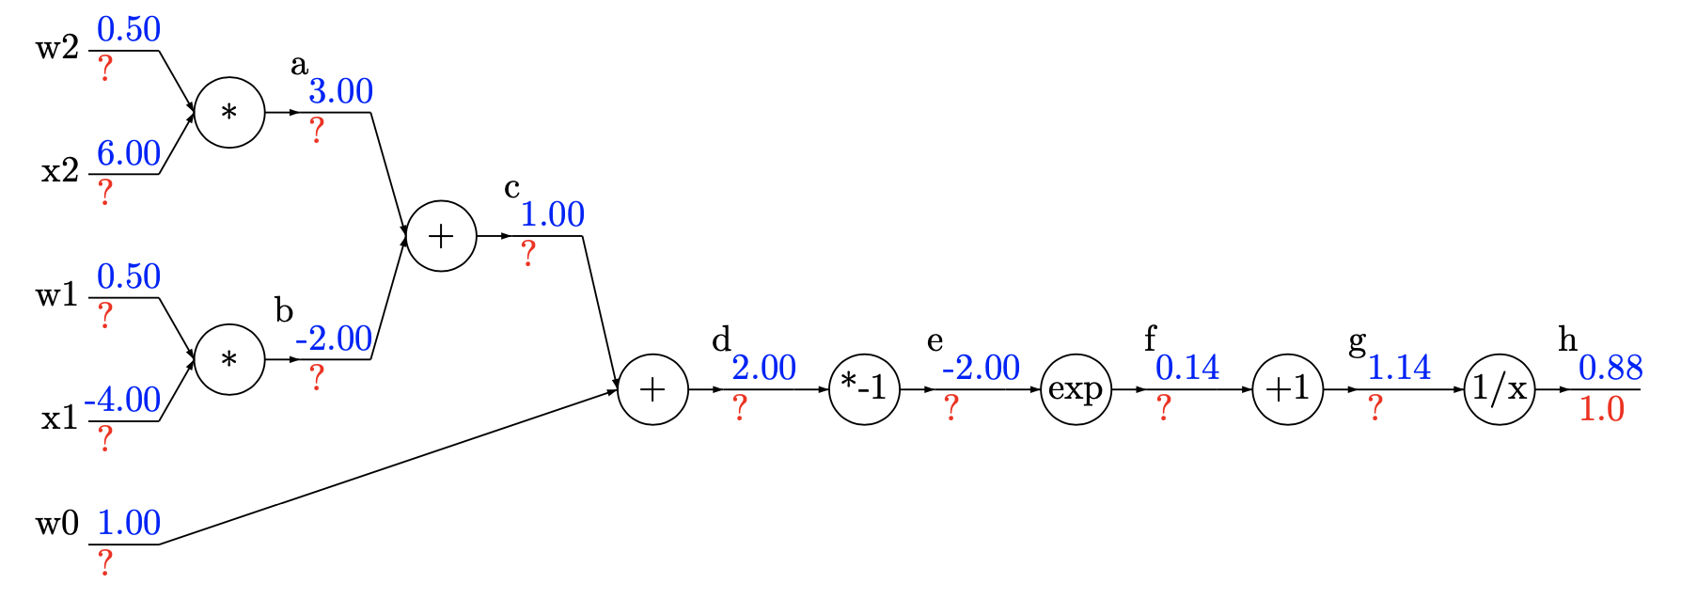
0.66
0.11
0.06
0.11
-0.44
0.11
0.11
-0.11
-0.77
-0.77
0.06
0.11

Slide 2
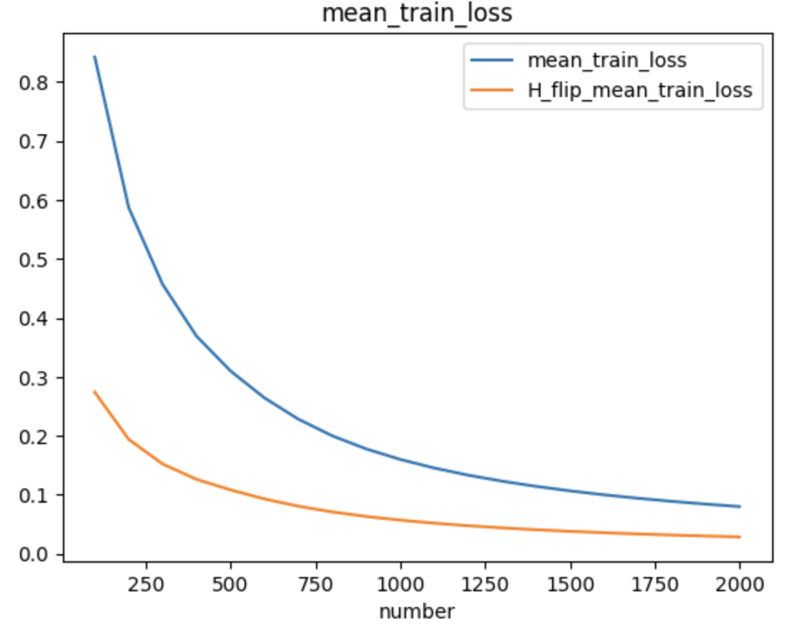
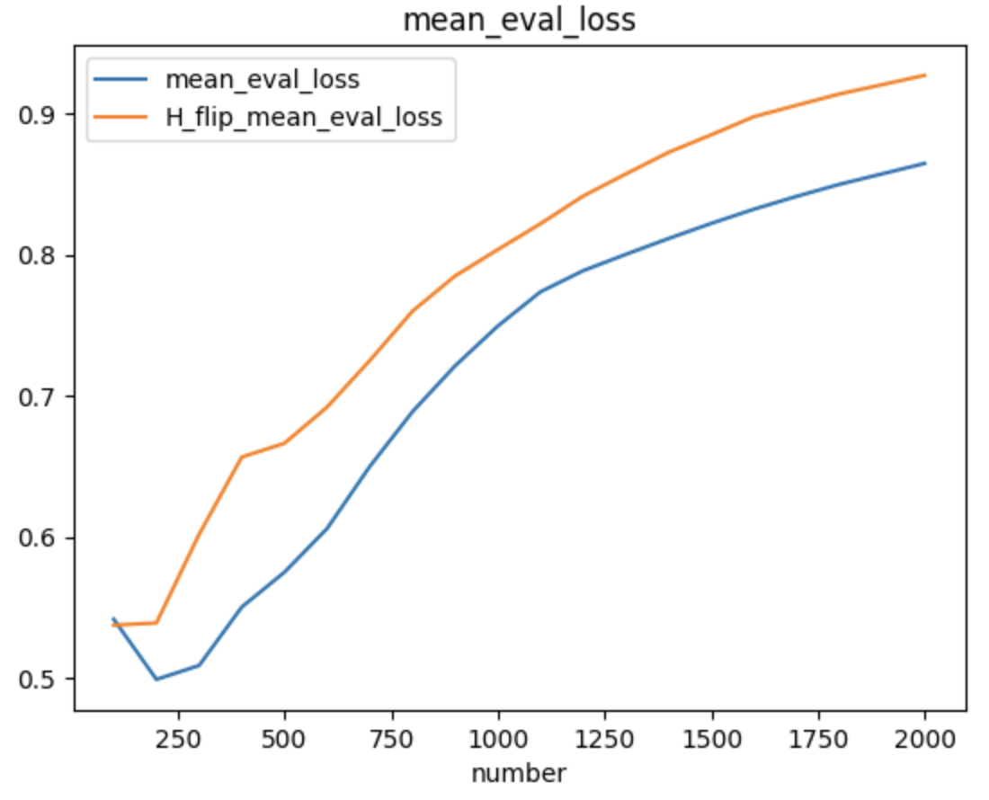

Slide 3
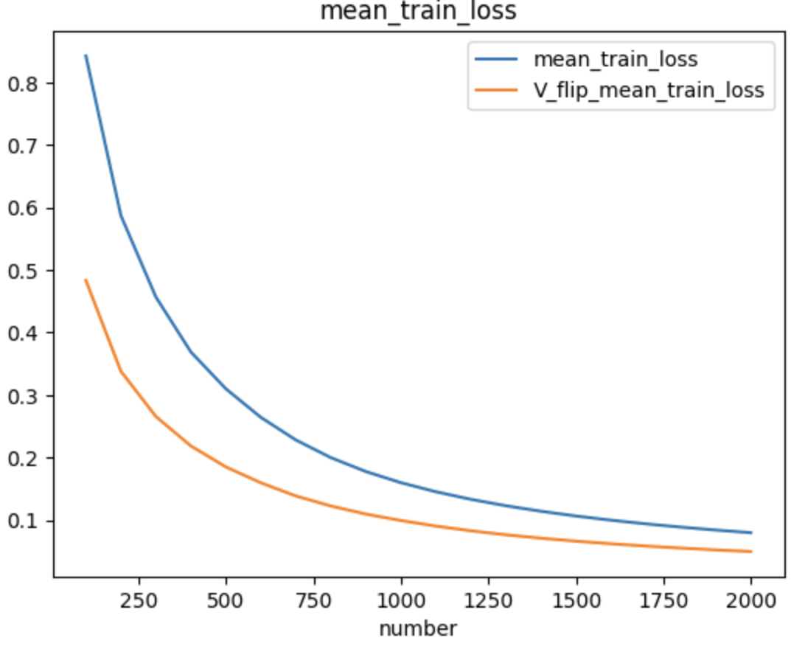
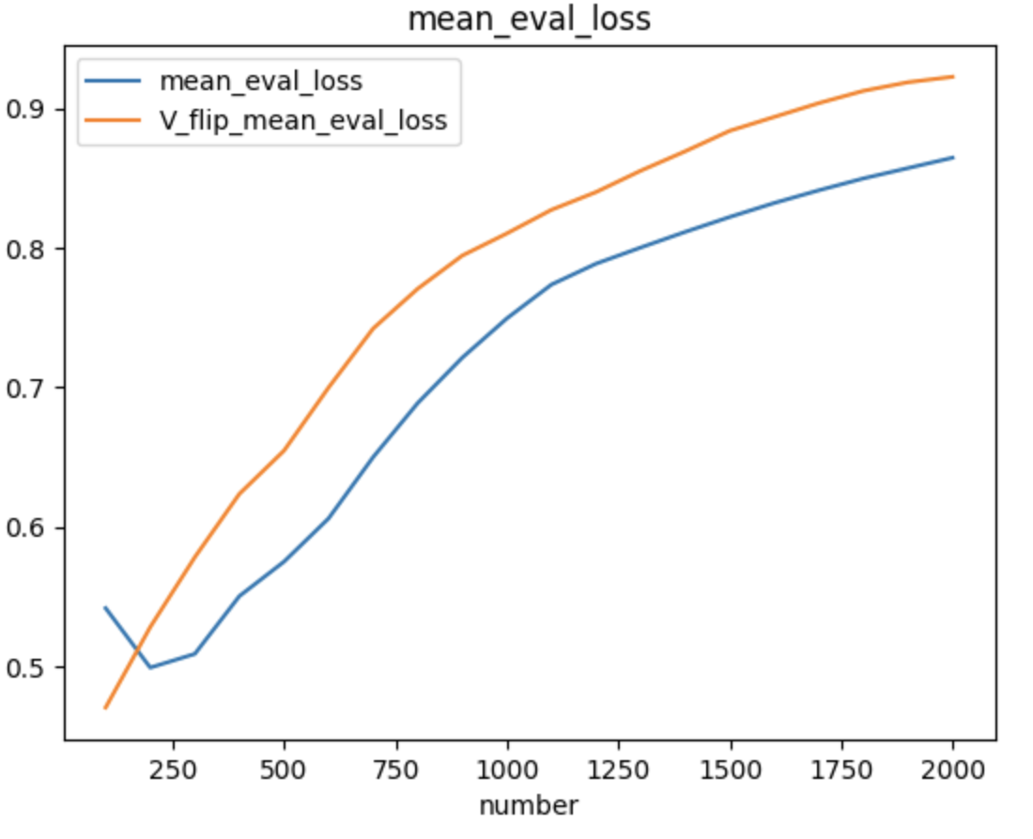

Slide 4
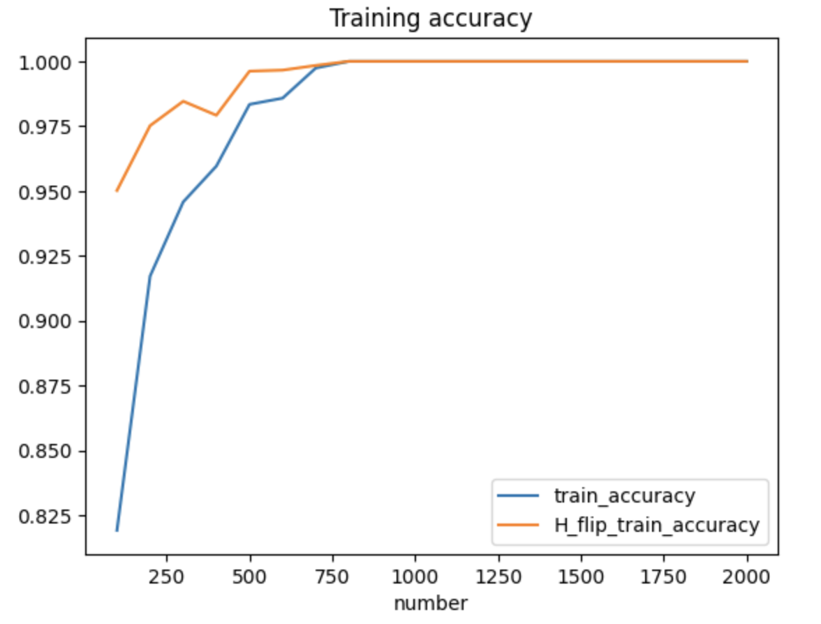
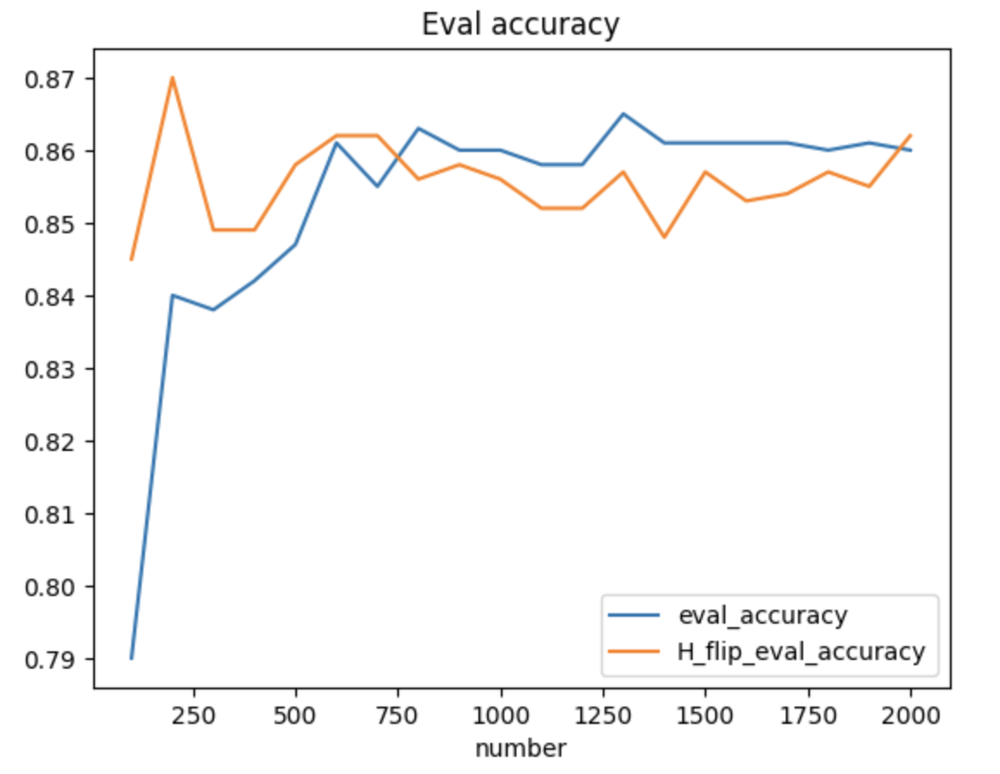

Slide 5
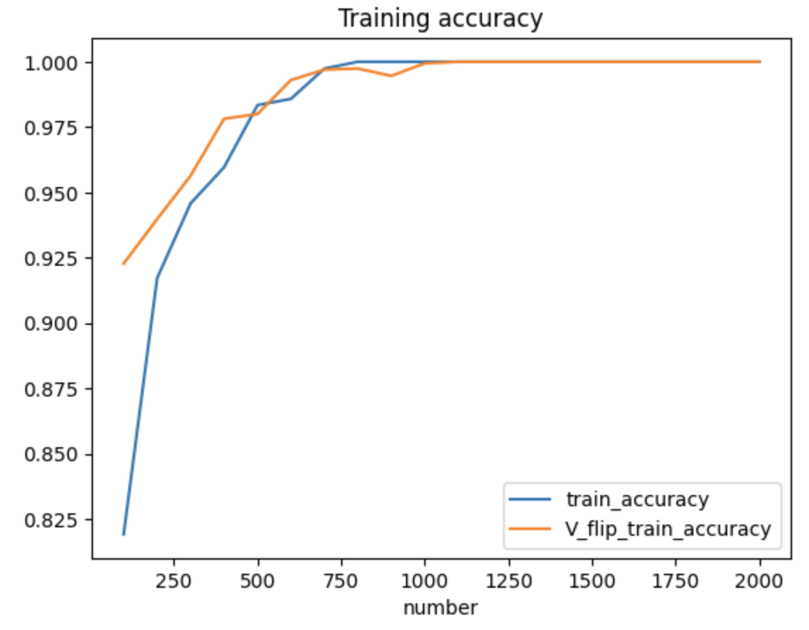
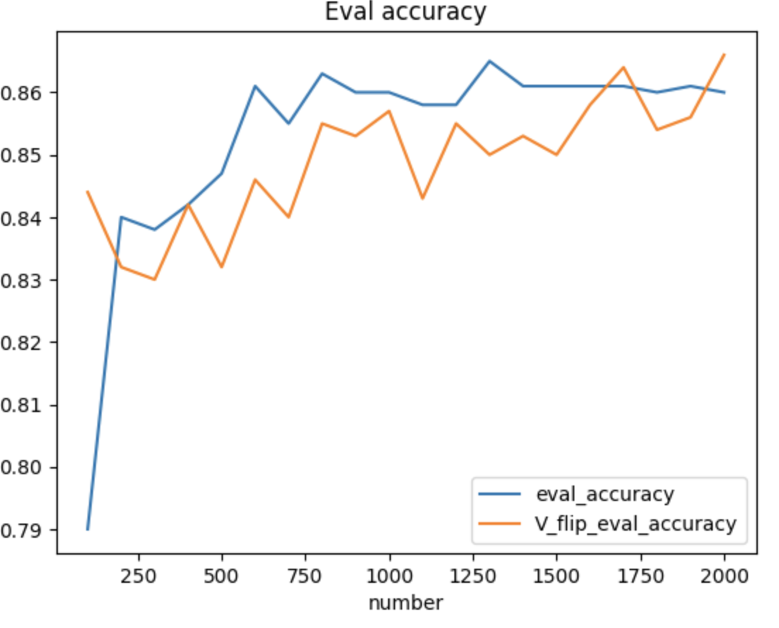

Slide 6
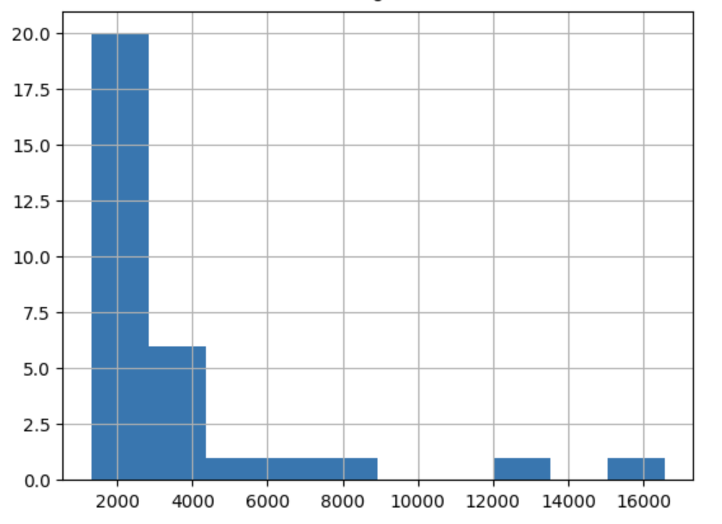
modi | 16569
the | 13003
and | 8457
for | 6367
you | 4913
not | 3599
that | 3582
this | 3541
india | 3510
are | 3496
will | 3443
with | 2580
has | 2547
have | 2443
but | 2361
all | 2178
his | 2021
was | 1998
from | 1855
they | 1835
people | 1781
who | 1775
bjp | 1614
your | 1595
like | 1579
what | 1546
our | 1483
congress | 1418
now | 1373
only | 1326
can | 1318

Slide 7
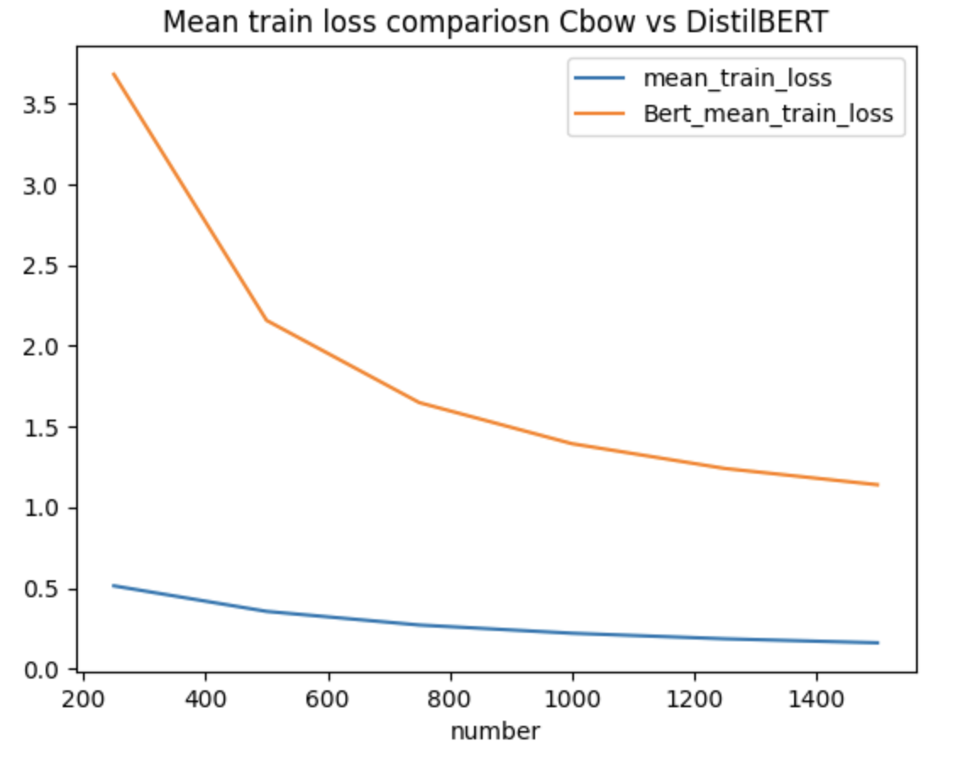
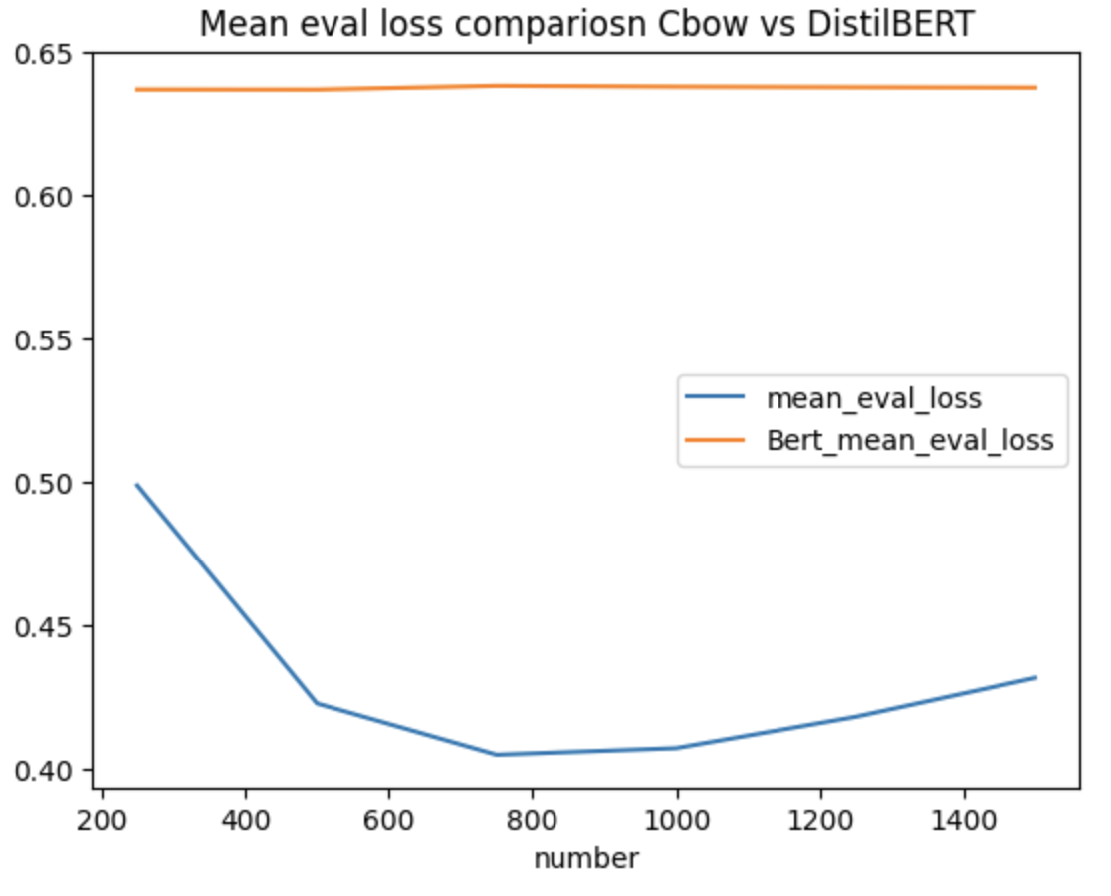

Slide 8
